Slide 1
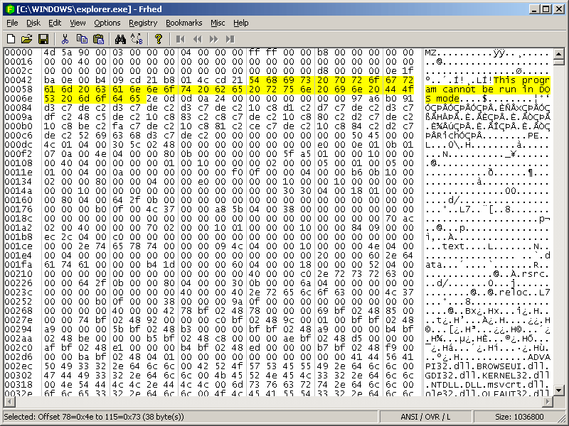

Dr: Nabil Ismail By :Amira Mohamed Menshawy

Slide 2

What can be parsed with Hex Editor?
Header: You can identify the "identifiers" that indicate the type of file.
Sections: Discover and identify strings, code, or other data.
Modification: Change values ​​or text in the extracted file to see how the program's behavior changes
https://mh-nexus.de/en/downloads.php?product=HxD20

Slide 3
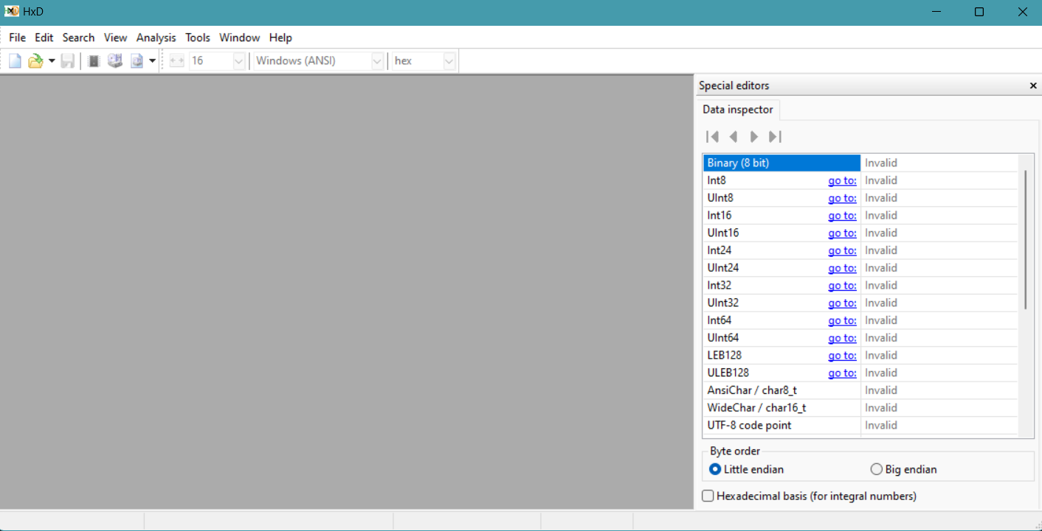
Now I have downloaded the hex editor, let's get started.

Slide 4
Example Activity: Analyze a file using the file command or a hex editor to determine its type and explain why its extension might differ from its actual content.
objective:
Analyze the real file type using its signature (Magic Number) instead of relying on its extension (Extension).
Detect disguised files that have their extension changed to mislead analysts.
Tools needed:
Hex Editor (like HxD on Windows or Hexcurse on Linux).
Linux or Terminal to use the file command.
A ready-made dummy file (we will create it).

Slide 5
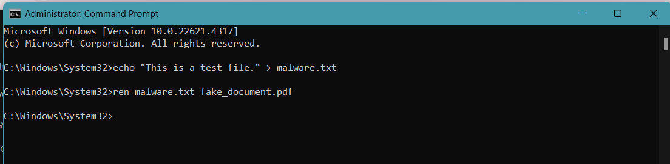
Step-by-Step Process:
1. Create a Disguised File:
Create a simple text file:
echo "This is a test file." > malware.txt
Rename it to a different extension (e.g., PDF extension):
ren malware.txt fake_document.pdf

Slide 6
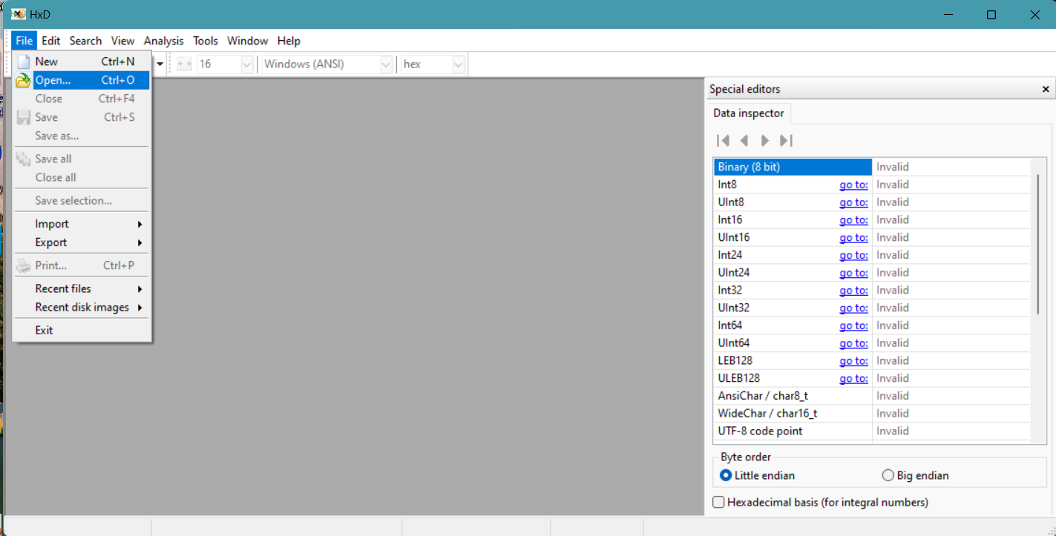
Step-by-Step Process:
2. Analyze the File Using Hex Editor:
Open the fake_document.pdf file using a Hex Editor.
Check the file signature (Magic Number).
You will notice that the signature does not match a PDF file (which usually starts with %PDF).
Instead, you’ll find the text "This is a test file."

Slide 7
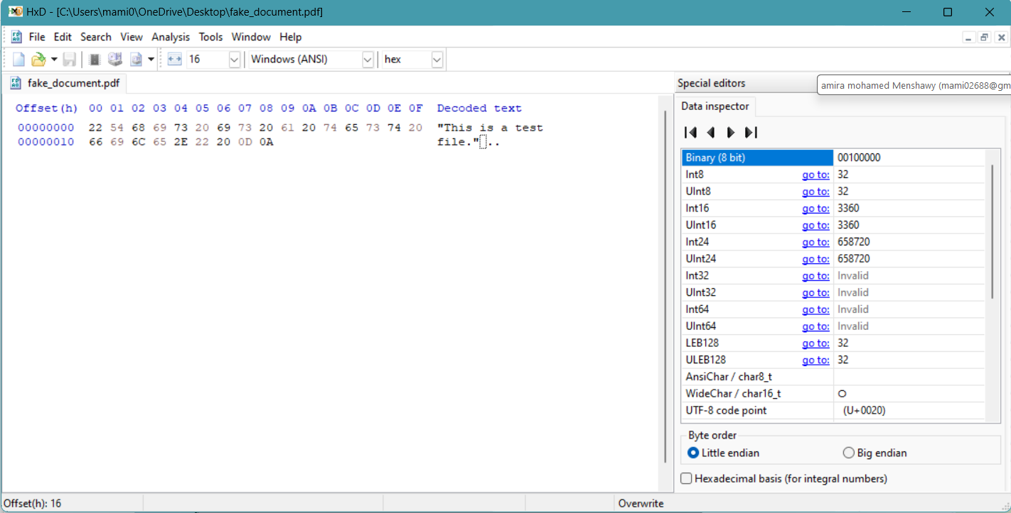
3.analyze the actual file type
Open the file in the Hex Editor and check the magic number (the first few bytes). For example:
Example of a typical PDF structure:
Start: %PDF-1.7 (or similar, indicating PDF version)
Content: The actual content of the PDF (e.g., text, images)
End: %EOF

Slide 8
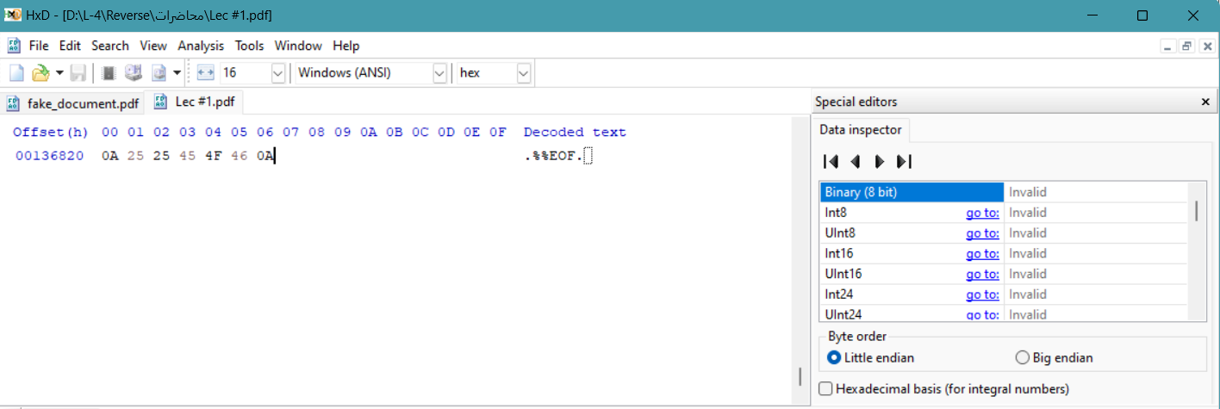
Open another PDF file that is real and not fake to see its end or beginning.
Open another PDF file that is real and not fake to see its end or beginning.

Slide 9
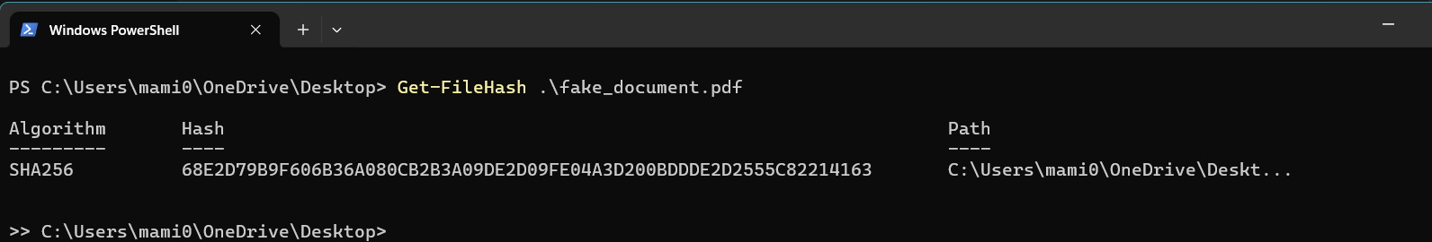
First hash (before modification):

Slide 10
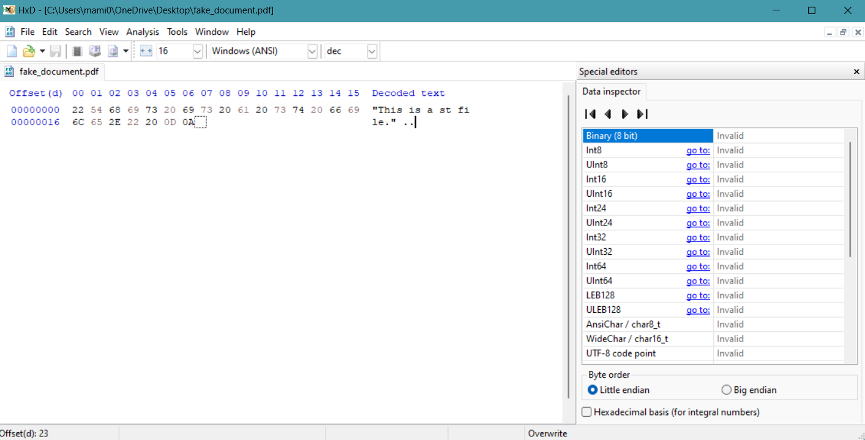
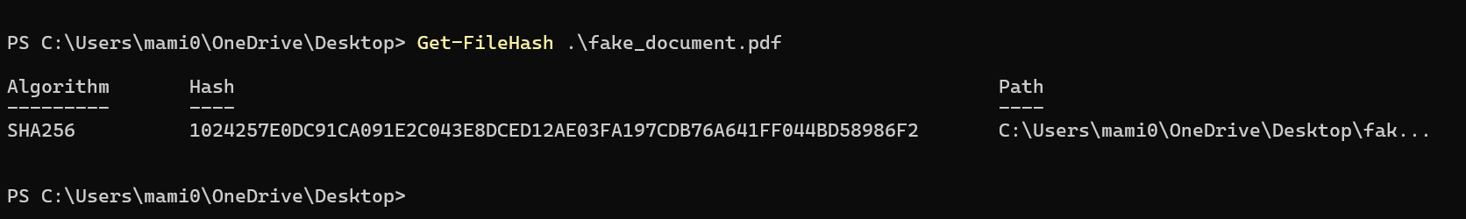
Modified hash (after modification):

Slide 11
When you run Get-FileHash .\fake_document.pdf, PowerShell computes the hash of the fake_document.pdf file.
The hash can be of different algorithms (like MD5, SHA256, etc.). By default, it uses SHA256.
Why it's useful:
File Integrity Check:
You can compare the hash of the file to an expected hash value to ensure the file has not been altered (e.g., if you download a file and want to verify it’s the correct, unmodified version).
Identifying Files:
The hash is unique to the file’s contents, so even if the file has a different name or extension, the hash will always remain the same unless the content changes. This helps in identifying files that might have been disguised.
The hash value changes when the content of the file changes. So, if you want to check whether a file has been modified, compare the current hash with the previous hash (or expected hash).

